Slide 1


Slide 2
Objectives
By the end of this session every student should be able to:
Define the district health area
Outline the components of health district area
Explain the main pillars of the district health system
Outline the characteristics of health district area

Slide 3
INTRODUCTION
The district is the most peripheral fully organized unit of local government and administration. It differs greatly from country to country in size and degree of autonomy, and population may vary from less than 50,000 to over 300,000.
It comprises first and foremost “a well-defined population living within a clearly delineated administrative and geographical area”.

Slide 4
INTRODUCTION – cont.
A district health system includes the interrelated elements in the district that contribute to health in homes, educational institutions, workplaces, public places and communities, as well as in the physical and psychosocial environment.
A district health system based on PHC is a self-contained segment of the national health system.

Slide 5
THE COMPONENTS OF A DISTRICT HEALTH SYSTEM
The following are some of the components of a district health system:
district health office;
district hospital or hospitals;
health centers;
community, neighborhoods and households;
private health sector, NGOs and mission health services.

Slide 6
THE MAIN PILLARS OF THE DISTRICT HEALTH SYSTEM
As the responsibility and authority for promoting, implementing and supporting Primary Health Care becomes part of the district operation, close attention will need to be paid to those aspects which can be regarded as the main pillars of the district health system.

Slide 7
THE MAIN PILLARS OF THE DISTRICT HEALTH SYSTEM – cont.
Organization, planning and management.
Financing and resource allocation.
Intersectoral action.
Community involvement.
Development of human resources.

Slide 8
1.ORGANIZATION, PLANNING AND MANAGEMENT
Refers to the organizational structure and the managerial process for establishing Primary Health Care.
This is a broad subject area and covers the roles, goals and responsibilities of different organizations and units in the district, programme planning, manpower planning, health and management information, monitoring and evaluation, coordination of programmes and activities within the health sector and with other non-governmental, private and community health organizations and agents, and the provision of drugs supplies.

Slide 9
2.FINANCING AND RESOURCE ALLOCATION
Are part of planning and management.
They are addressed separately to denote their key role in developing and sustaining health services.
They are highlighted to draw attention to the need for the district to take an active role in resource allocation decisions, identification of sources of financing and development of useful financial information systems.

Slide 10
3.INTERSECTORAL ACTION
Concerns the promotion and coordination of different sectors‘ contributions to health and improvement of the quality of life.
It covers environmental changes, such as clean water, improved sanitation and housing, better food supplies and the raising of income and educational levels as means of improving health.
Achieving equity and reaching vulnerable groups are critical issues that require intersectoral perspectives and collaboration.

Slide 11
4.COMMUNITY INVOLVEMENT
Addresses itself to the task of mobilization, putting in motion a widespread process of collective organization and involvement which leads to increased human and material resources at the local level being channeled into development efforts.
It seeks to create support mechanisms in order to establish the preconditions for full participation and to clear the way for the required changes.
It is also concerned with community health workers and with other change agents in the community.

Slide 12
5.DEVELOPMENT OF HUMAN RESOURCES
Requires a comprehensive manpower policy for the entire system from the definition of manpower needs through basic training orientation, career development and working conditions.
In the district, human resource development is concerned with the provision of relevant in-service training and support and supervision, and the re-orientation of health workers based on competency profiles rather than on outdated duty schedules.

Slide 13
CHARACTERISTICS OF A DISTRICT HEALTH SYSTEM
Justify the costs involved for investment in and management of health services, particularly where hospitals are concerned.
Take account of the demographic and socio-economic situation.
Communication with the target population and its participation in planning and organization.
Intersectoral cooperation can take place.

Slide 14
FUNCTIONS OF HEALTH SYSTEMS
HEALTH SYSTEM FUNCTION | NATIONAL SYSTEM | DISTRICT SYSTEM
STEWARDSHIP | Regulatory functions | Implement and enforce regulations
 | Policy formulation | Interpret and implement policies
 | Setting standards | Interpret and enforce standards
RESOURCE GENERATION | Human resource development strategy and plan | Assessment of local human resource need
 | Development of a national equipment policy | Routine maintenance of equipment and infrastructure
 | Training of high and middle level health workers | Continuing education of health workers

Slide 15
FUNCTIONS OF HEALTH SYSTEMS – cont.
HEALTH SYSTEM FUNCTION | NATIONAL SYSTEM | DISTRICT SYSTEM
SERVICE DELIVERY | Tertiary health care services | Identification of health care needs and prioritization of services.
 | Technical back up and support supervision | Encourage community based care
 | Setting standards | Ensuring client / customer satisfaction.
FINANCING | Financing strategies | Allocation of funds to activities
 | Donor coordination | Implementation of insurance and prepayment schemes
 | Development of pooling mechanisms | Implementing co-finance schemes.

Slide 16
LEVELS OF HEALTH CARE REFERRAL
The different levels of health facilities in the district are referred to as the “Referral system” or “Health pyramid”.

Slide 17
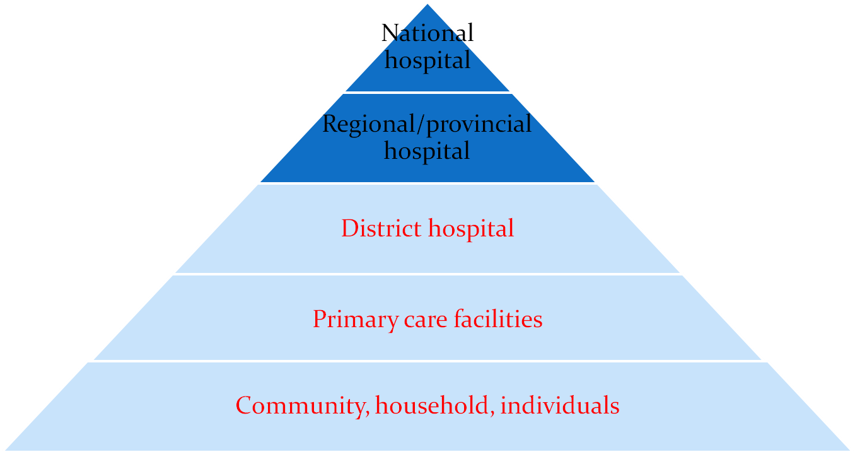
LEVELS OF HEALTH CARE REFERRAL – cont.

Slide 18
DEVELOPMENT OF ESSENTIAL HEALTH PACKAGE
Needs defined by
health professionals
Demands defined by
community
Other factors:
political, resource,
legal
Consensus on EHP
Needs agreed upon by
both professionals and
community through
dialogue or participatory
rural appraisal process

Slide 19
DEVELOPMENT OF ESSENTIAL HEALTH PACKAGE – cont.
Minimally the district hospital is expected to offer the following as part of the district essential health package:
Outpatient care for those who can be managed on ambulatory basis;
Supportive medical care of critically-ill patients who are hospitalized;
Diagnostic services such as laboratory, radiology and ultrasound;

Slide 20
DEVELOPMENT OF ESSENTIAL HEALTH PACKAGE – cont.
Continuing education for health workers within the hospital and from primary care facilities;
Conducting of research, both operational and intervention studies;
Reverse referral of patients to continue with follow-up care in their local health care facilities;
Referral of patients to consultant (tertiary) hospitals.

Slide 21
EXAMPLE OF STANDARDS OF HEALTH CENTERS, SUDAN FMOH
CLASSIFICATION | STANDARDS
 | Population | Geographical location | Number of EHP | Health personnel
Referential Family Health Center | 50 – 60 thousand | 5 km. | 16 – 38 | Specialist Family Physician Specialists
Family Health Center | 10000 urban areas 5000 rural areas | 2 km. urban areas 5 km. rural areas | 10 | Family Physician (Msc.) or Medical Officer
Family Health Unit | 1 - ˂ 5 thousand | 3 km. | 8 | Medical Officer or medical assistant
Community Health Package | ˂ 1000 | - | Mainly preventive and referral services | Health Worker

Slide 22


Slide 23

شكرا

